Slide 1
Geospatial Data Science
Week 7 Session 1
Lecture and Slides by Jazzie R. Jao | jazzie.jao@dlsu.edu.ph

Slide 2
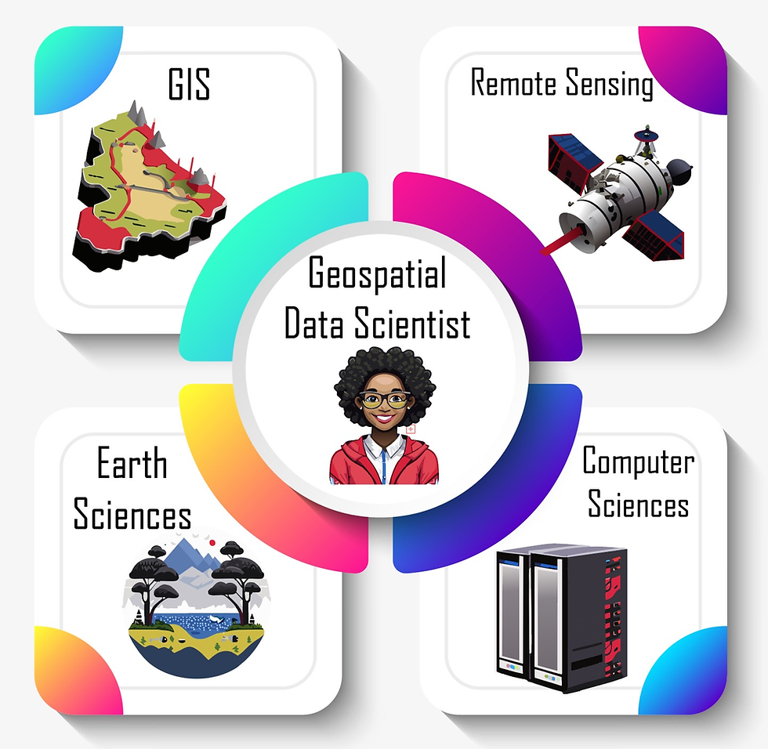
Geospatial Data Science
Geospatial data science deals with the analysis and interpretation of data with a spatial component. Common geospatial data types include point data, raster data (gridded), and vector data (polygon, line, point).

Slide 3
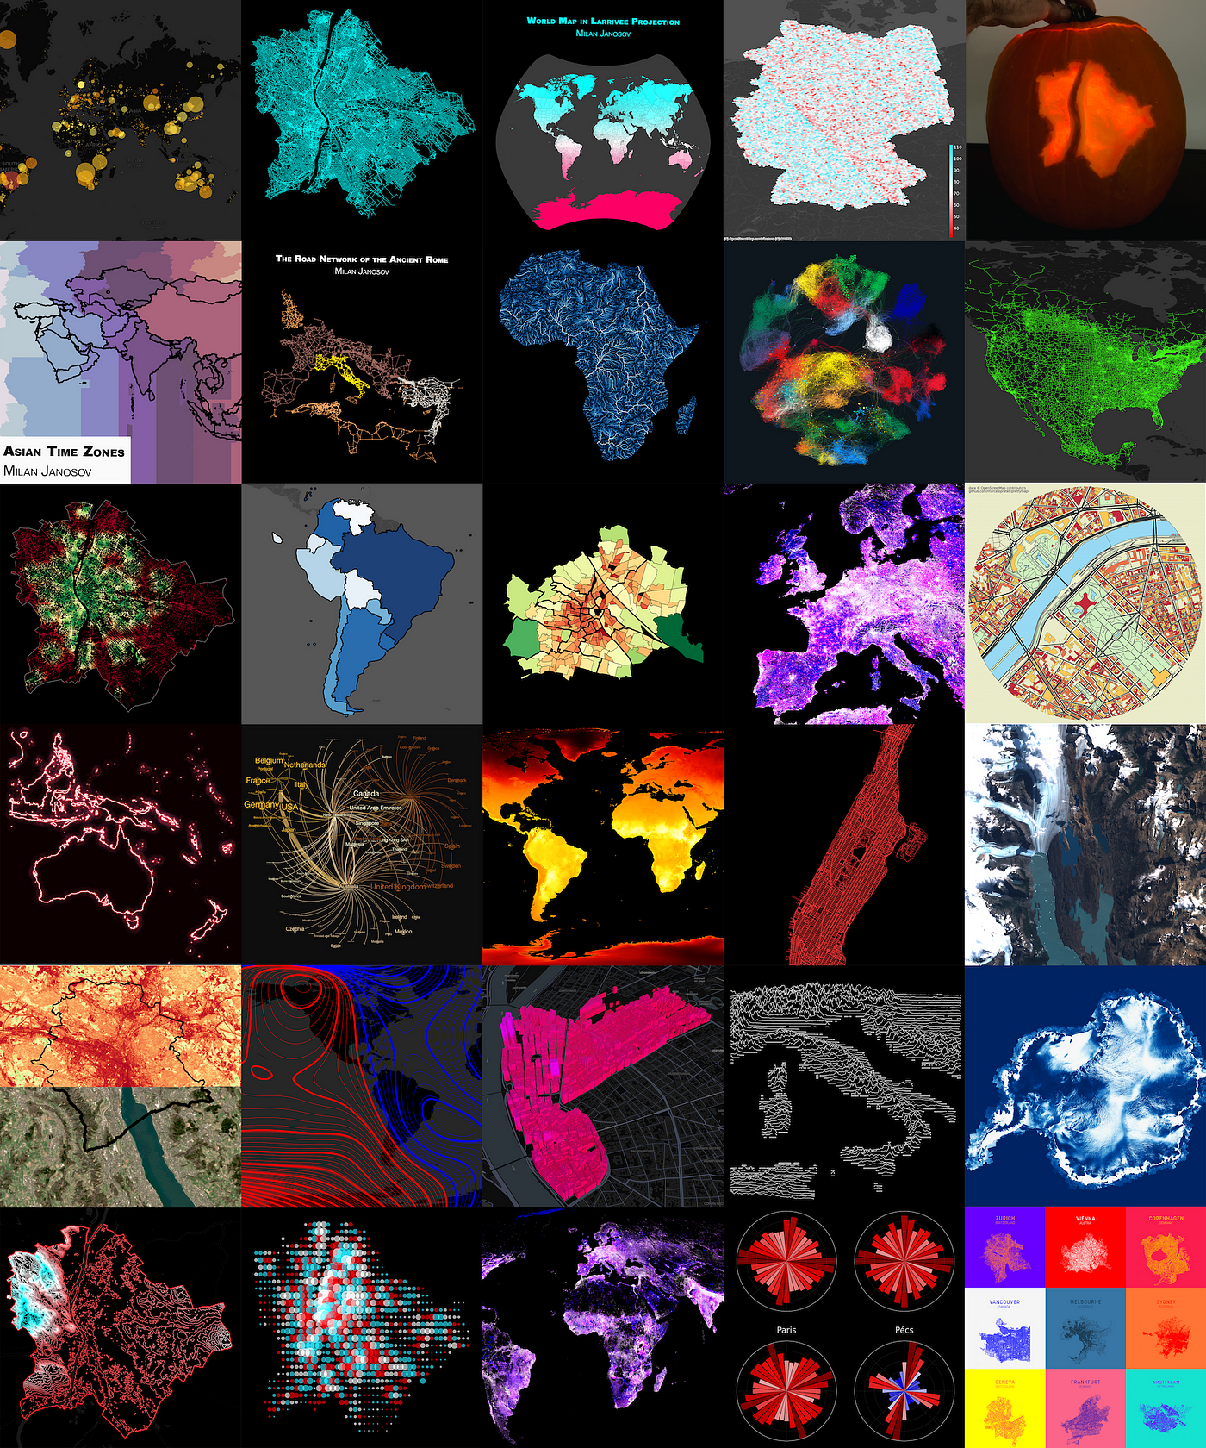
Geospatial Data Science
Geospatial data science deals with the analysis and interpretation of data with a spatial component. Common geospatial data types include point data, raster data (gridded), and vector data (polygon, line, point).

Slide 4
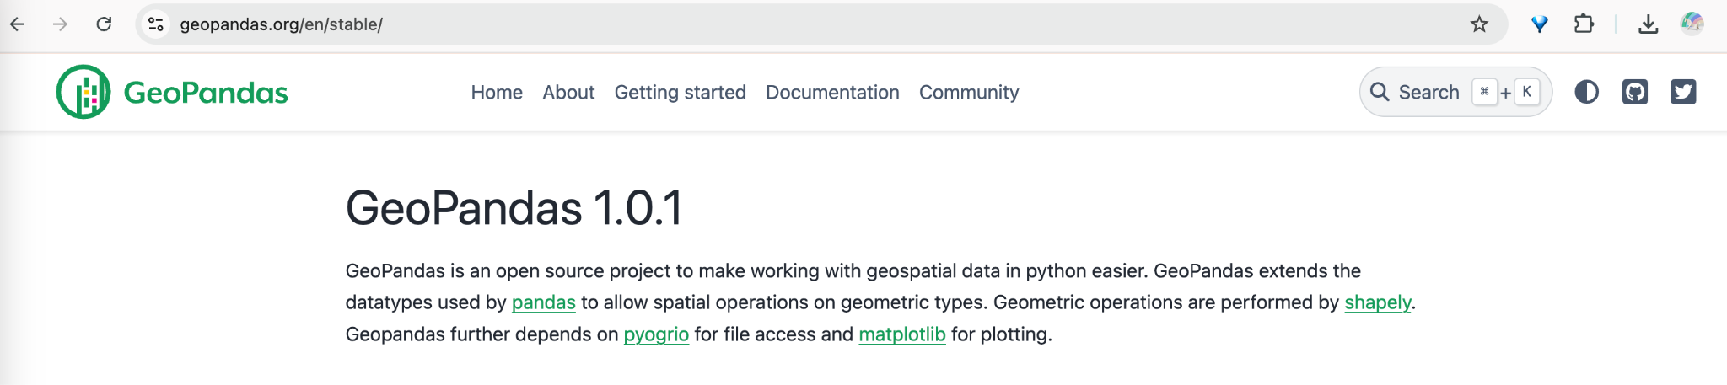
Python Toolbox (Common)
Geopandas (for vector data, handles data like points, lines, and polygons)

Slide 5
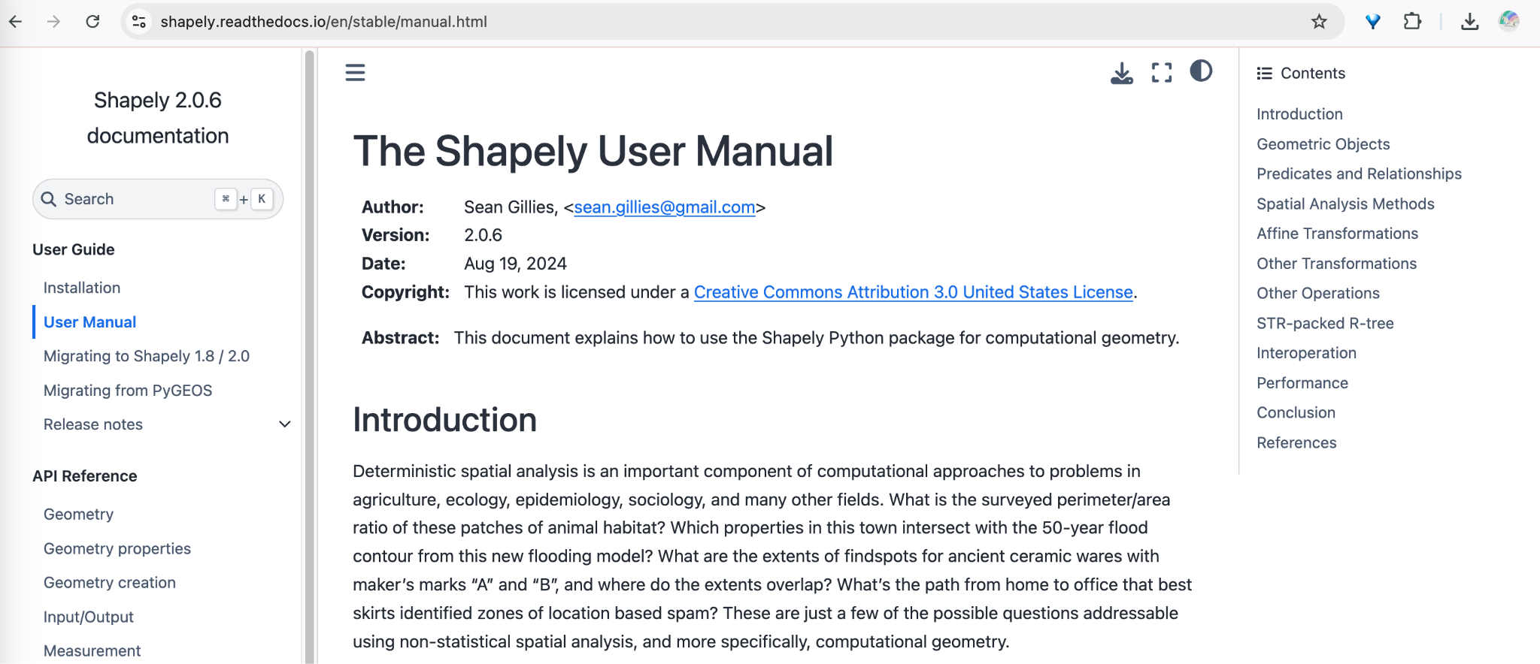
Python Toolbox (Common)
Shapely (for geometric operations)

Slide 6
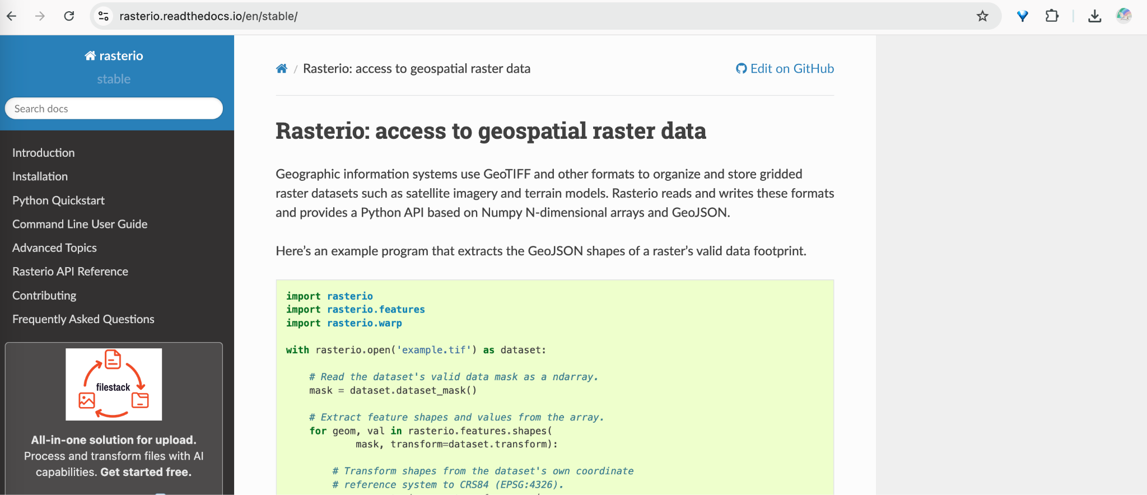
Python Toolbox (Common)
Rasterio (for raster data)

Slide 7
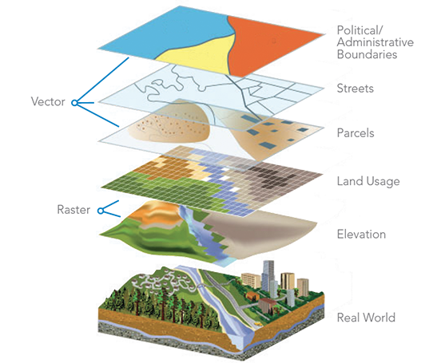
Geospatial Data Representation
Vector Data (Points, Lines, Polygons):
Points (x,y)
Lines as sequences of points
Polygons as closed loops of points
Geometries are defined by coordinate systems (e.g., geographic coordinates or projected coordinates). Transformations between coordinate systems are handled using affine transformations (rotation, scaling, translation).

Slide 8
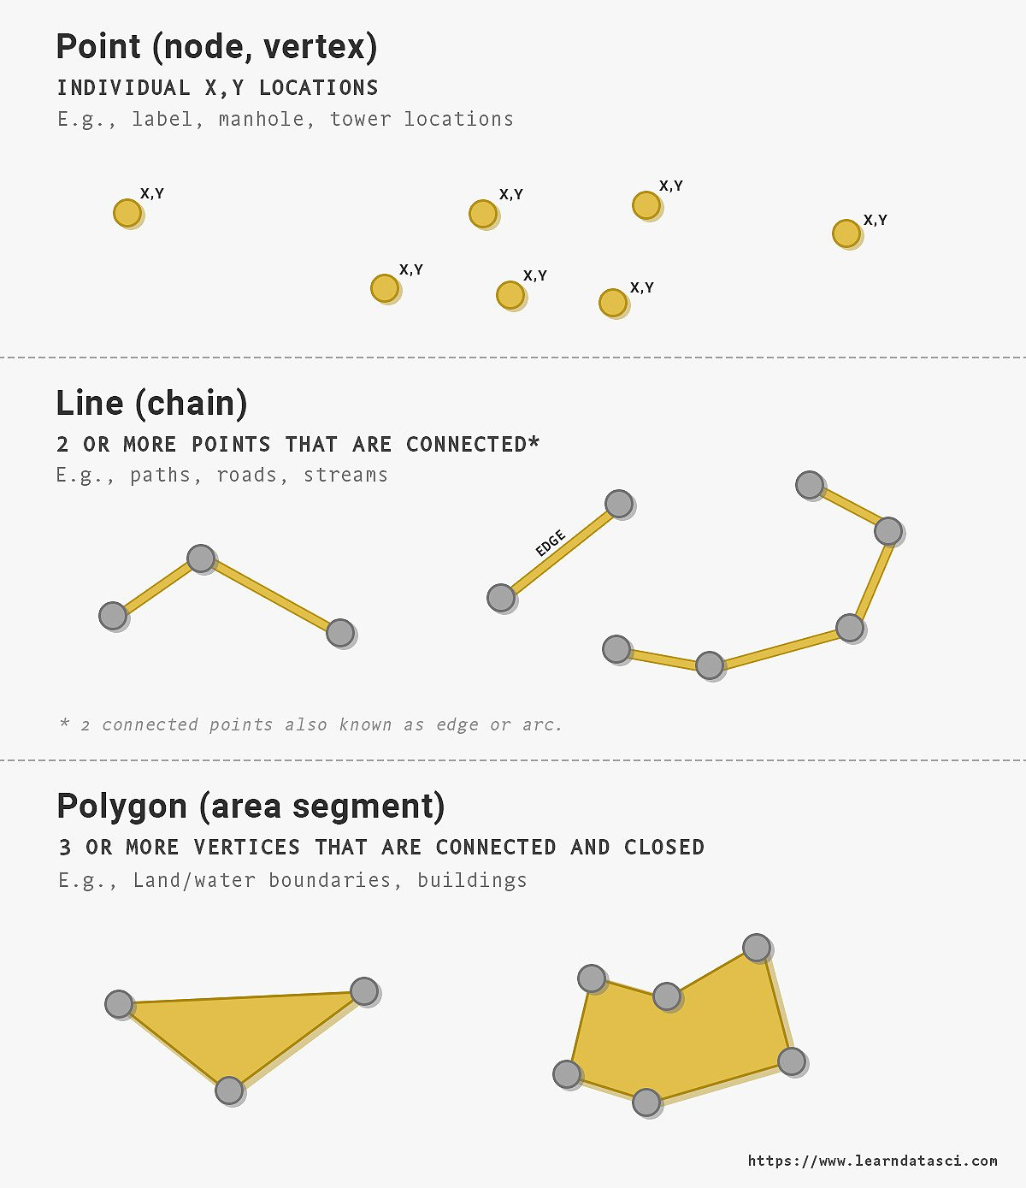

Slide 9
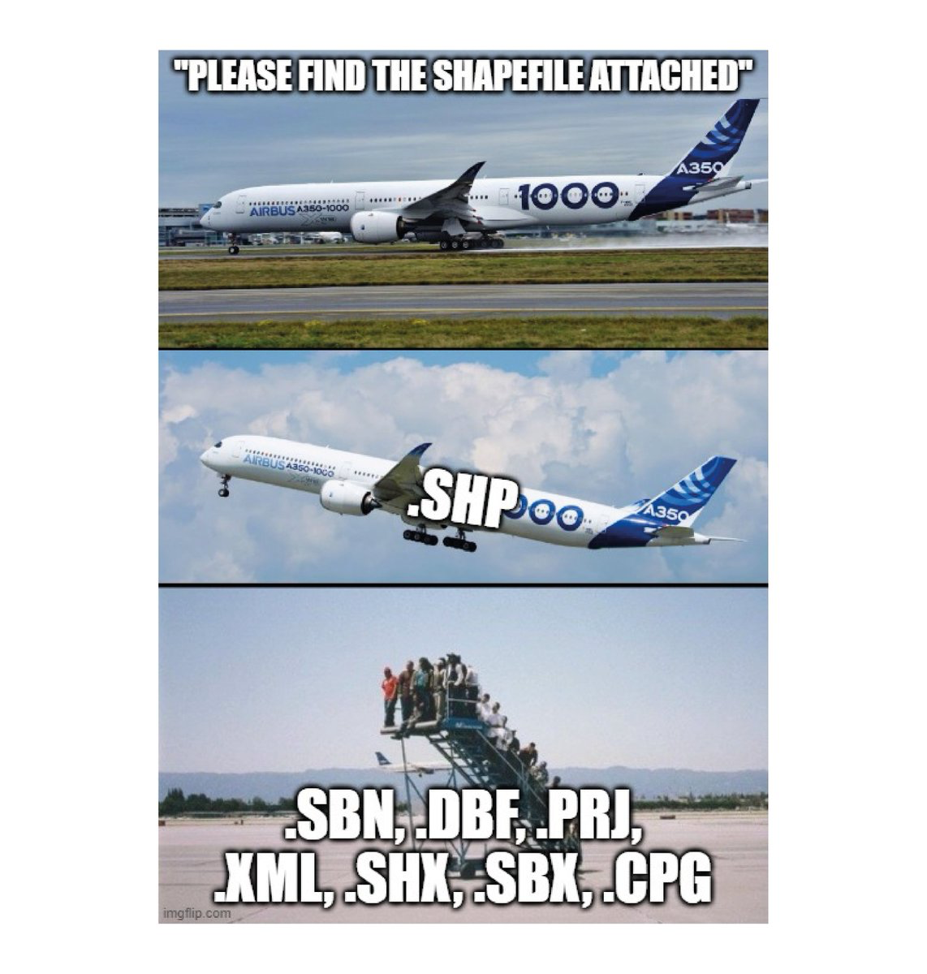

Slide 10
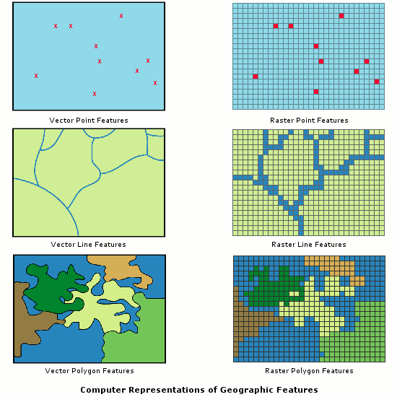
Geospatial Data Representation
Raster Data (Grids):
Raster data is represented by a grid of cells, each associated with a value. Common examples are satellite images, digital elevation models (DEM).
Mathematical Background: A raster dataset can be viewed as a matrix, where each entry corresponds to a value in a spatial location.

Slide 11
